Slide 1
Food Search App using React JS
By Ishmal Tahir

Slide 2
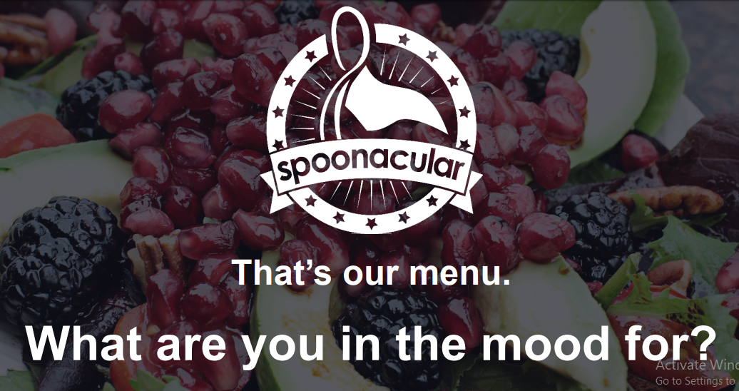
Spoonacular
API used in this project to get the food items.

Slide 3
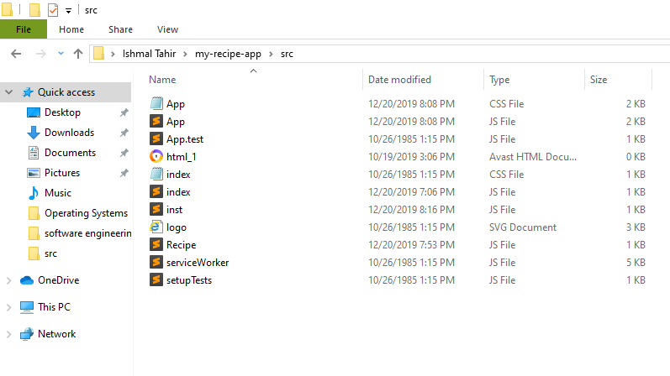
Source Files

Slide 4
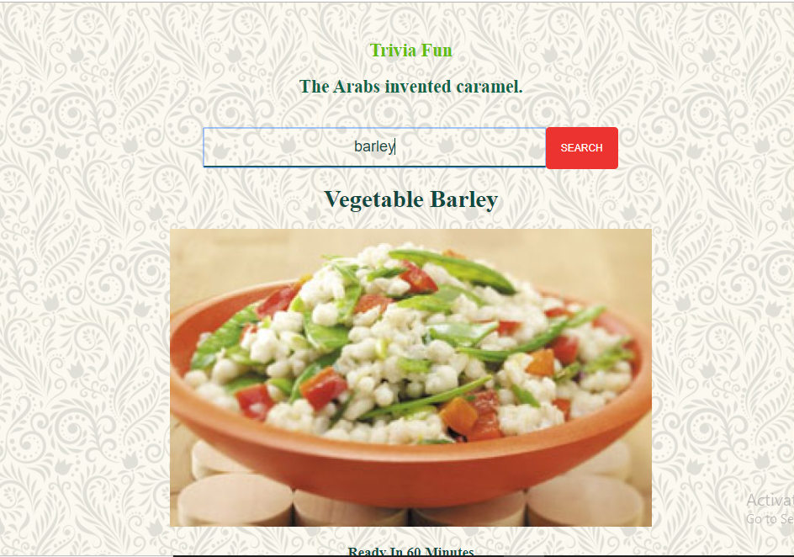
Search for your favorite foods
Some health benefits of barley:
Can help with weight loss;
Helps control blood sugar levels and improve insulin response, reducing risk of type 2 diabetes;
Helps reduce blood pressure;
High in potassium and low in sodium and fat.

Slide 5
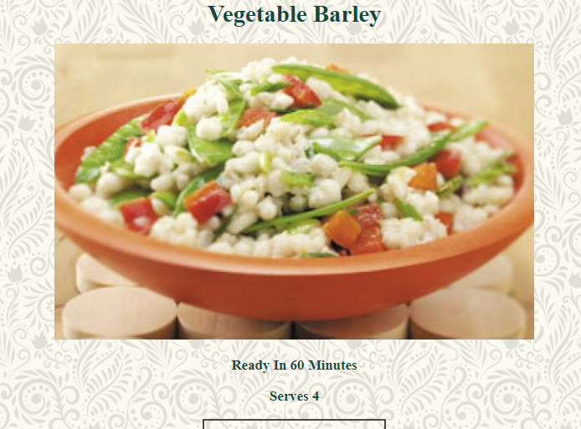
And see how long it will take to cook
You can invite your friends over too!

Slide 6
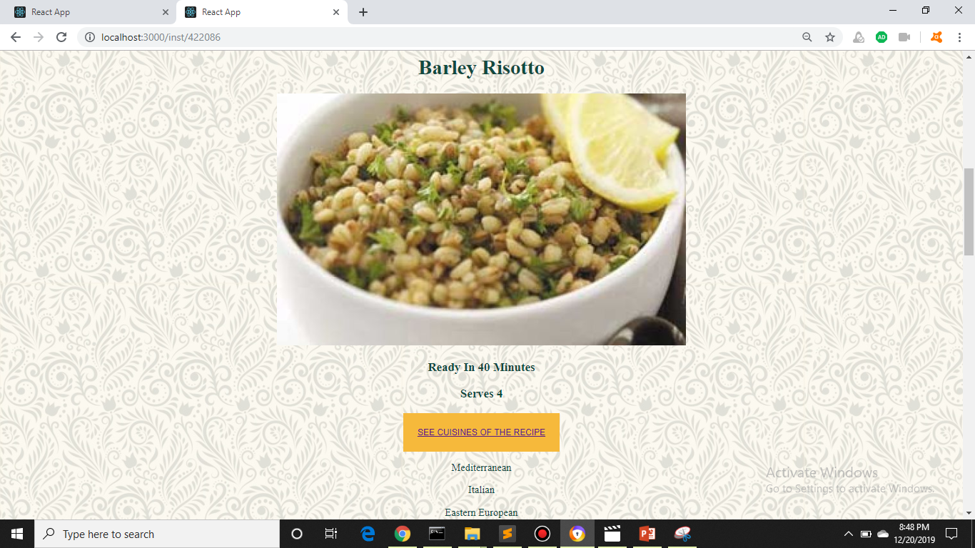
See cuisines of all the recipes

Slide 7


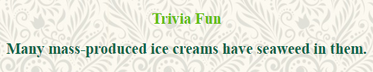



Random Food Trivia to keep you interested

Slide 8
Thank You

